Slide 1
Italian restaurants in Toronto
By: Aljawharah Alareefi

Slide 2
Introduction
Toronto is the provincial capital of Ontario and the most populous city in Canada.
Food is a big deal in Toronto.
In this project, we will try to analyze all the Italian Restaurant currently present in Toronto's different neighborhood

Slide 3
Business problem:
we are looking for a location in the city of Toronto to open an Italian restaurant. The study must include the all the Italian restaurants and how they are distributed in the city and the places where they are concentrated.

Slide 4
Target Audience:
Business Analyst :who are interested to invest and launch new Italian Restaurant in Toronto.
Foreign-born population: find out the top place to visit for Italian Cuisine in Toronto.
Tourists :who are eager to taste various cuisines including Italian dishes.

Slide 5
Data sources
Toronto neighborhood data: Wikipedia.
latitude and the longitude coordinates of each neighborhood :https://cocl.us/Geospatial_data.
Venues of all Italian restaurant in Toronto city: Foursquare APIs

Slide 6
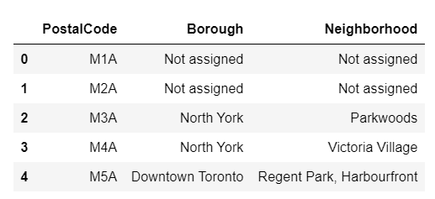
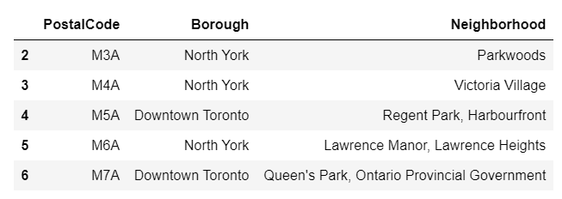
Methodology:
Gathering the Data
Cleansing Data

Slide 7
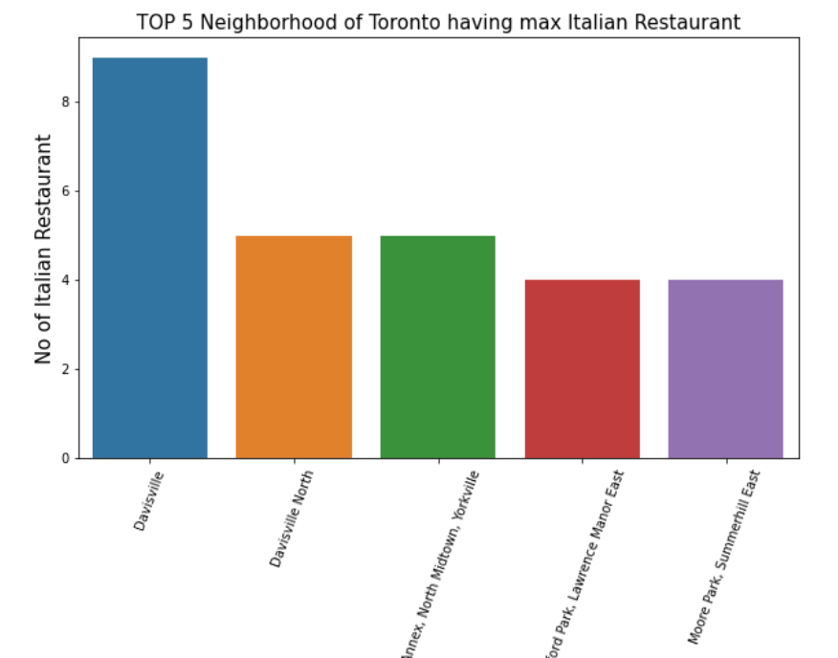
Methodology:
Explore Data

Slide 8
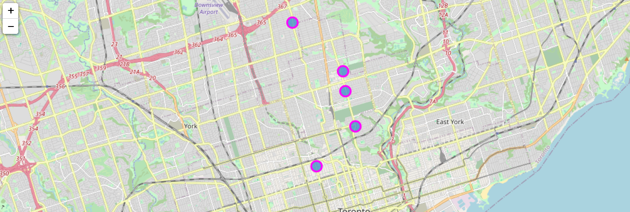
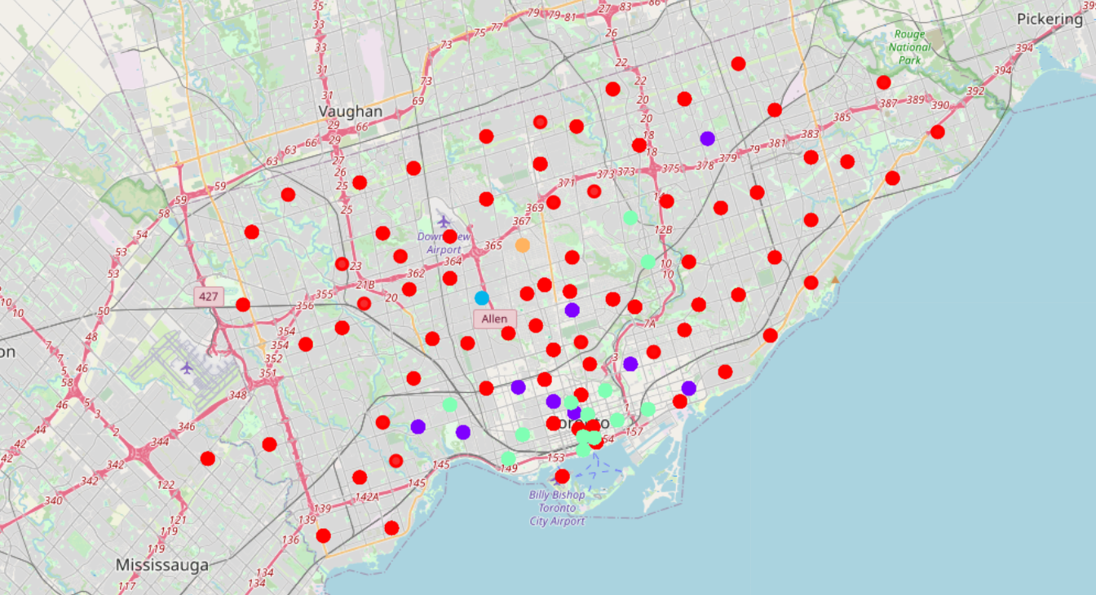
Methodology:
Visualize in map
Using ML to Clustering of the neighborhoods

Slide 9
Results and Discussion
Central Toronto Borough has 34 Italian restaurants followed by Downtown Toronto has 24 and East Toronto which has 9 Italian Restaurant whereas York Borough has least Italian Restaurant preset its count is only 2 in Toronto City respectively.
You can start your business in York Borough .
Davisville Neighborhoods has maximum no of Italian Restaurant with a count of 9 followed by Davisville North which has 5 Italian Restaurant each in Toronto City respectively and each of them fall under Central Toronto Borough
Most of Italian cluster under cluster 3

Slide 10
Conclusion:
I have explored the different Borough, Neighborhood of Toronto city and analyse the data to get different outcome for Italian Restaurants of different parts of the city. I have also used Machine learning technique K-Means clustering to cluster the neighborhoods and predicted a result which may help many business enthusiasts for opening Italian Restaurant in Toronto city

Slide 11
Thank you

